Slide 1
OAuth
Overview of the attack
Attack Target: the client registration phase and the client authentication process
Result: Recognize the adversarial client as a registered honest client (impersonate), and authorize it to honest authentication/authorization server
Methodology: security and functional Extensions
Security-related extension: providing a better integrity and authenticity of some messages or keep the protocols secure even if certain values leak.
Pushed Authorization Requests (PAR)
Token Revocation
Proof Key or Code Exchange
Functional extensions: allowing client retrieve AS configuration and automatically register at AS
Dynamic Client Registration
Automatic discovery of AS configuration
AS configuration: AS endpoints

Slide 2
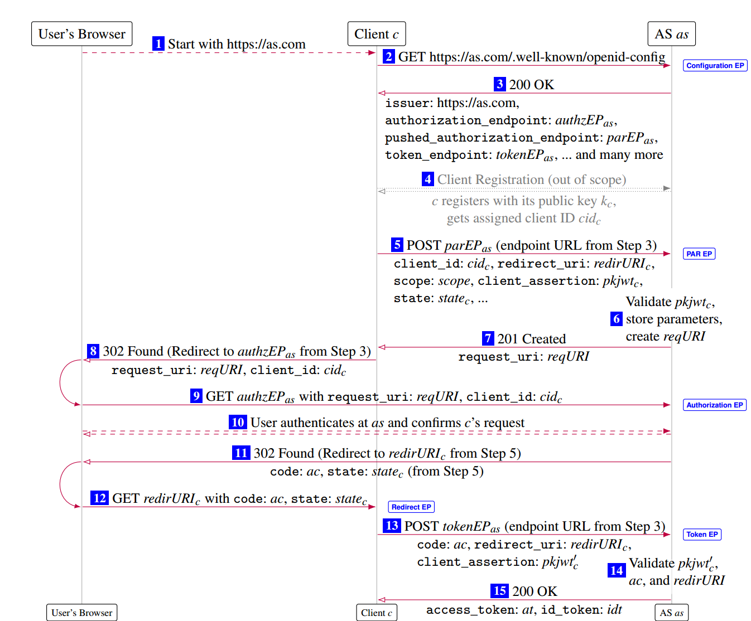
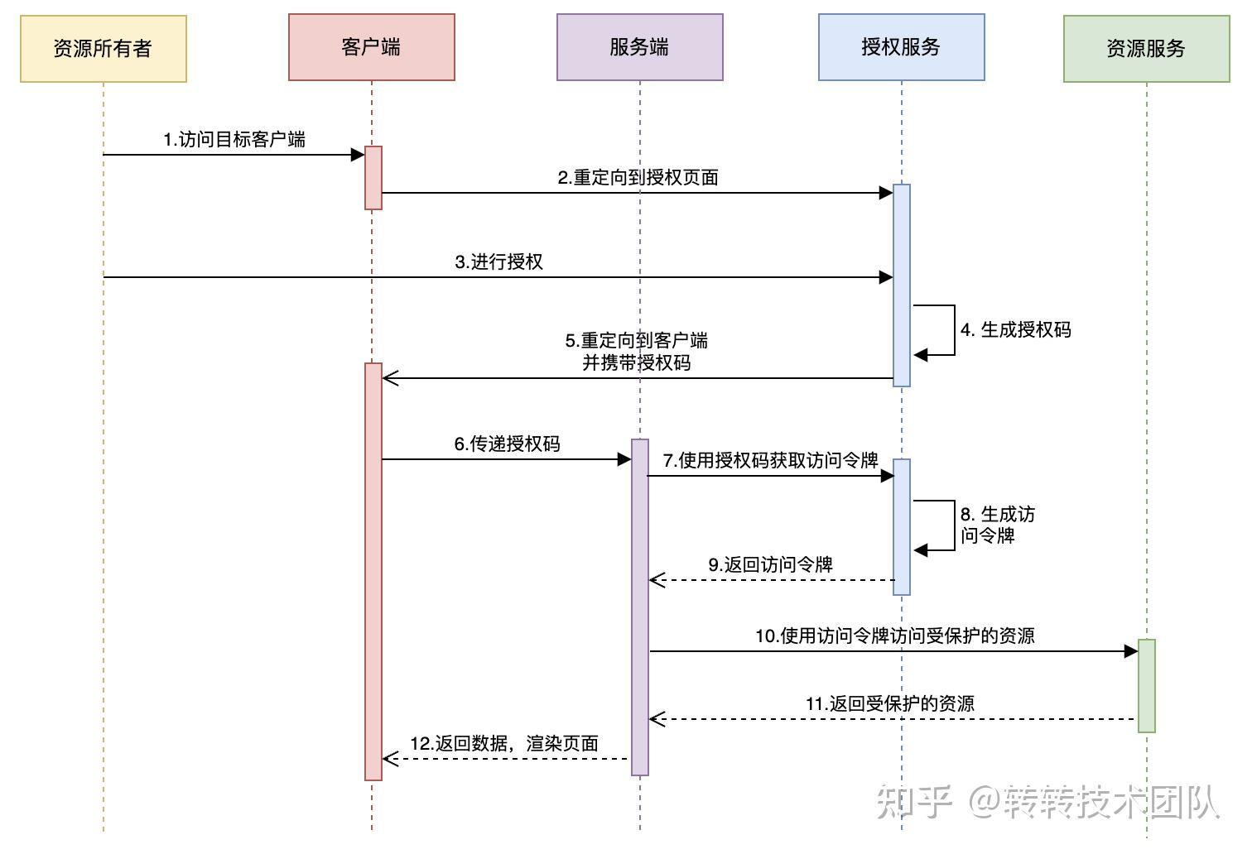
OAuth

Slide 3
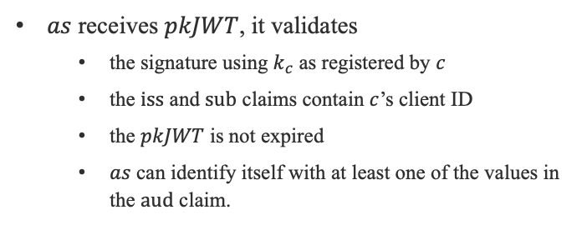
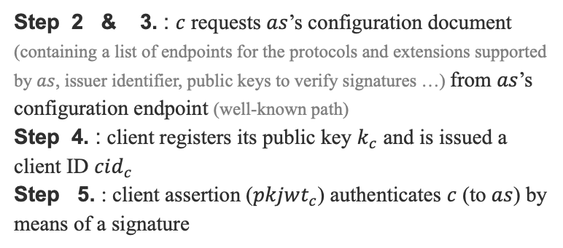
OAuth
Cient $c$ does not yet have a relationship with $as$
Step 2 & 3. : $c$ requests $as$’s configuration document (containing a list of endpoints for the protocols and extensions supported by $as$, issuer identifier, public keys to verify signatures …) from $as$’s configuration endpoint (well-known path)
Step 4. : client registers its public key $k_{c}$ and is issued a client ID $cid_{c}$
Step 5. : client assertion ($pkjwt_{c}$) authenticates $c$ (to $as$) by means of a signature
2
3
4
5
$pkJWT≔(<iss:{cid}_{c}$, $sub:cid_{c}$, $aud:tokenEP_{as}$, $jti:nounce$, $exp:time>, {\hat{k}}_{c})$
$as$ receives $pkJWT$, it validates
the signature using $k_{c}$ as registered by $c$
the $iss$ and $sub$ claims contain $c$’s client ID
the $pkJWT$ is not expired
$as$ can identify itself with at least one of the values in the $aud$ claim.
6

Slide 4
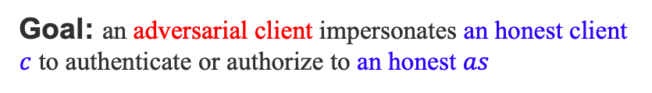
Audience Injection
Goal: an adversarial client impersonates an honest client $c$ to authenticate or authorize to an honest $as$
Phase 1: obtain a valid client_assertion, signed by an honest client c, with an aud value that will be accepted by an honest AS as.
Phase 2: use one or more client assertions to gain access to user’s resources or to log in to a client under an honest user’s identity

Slide 5
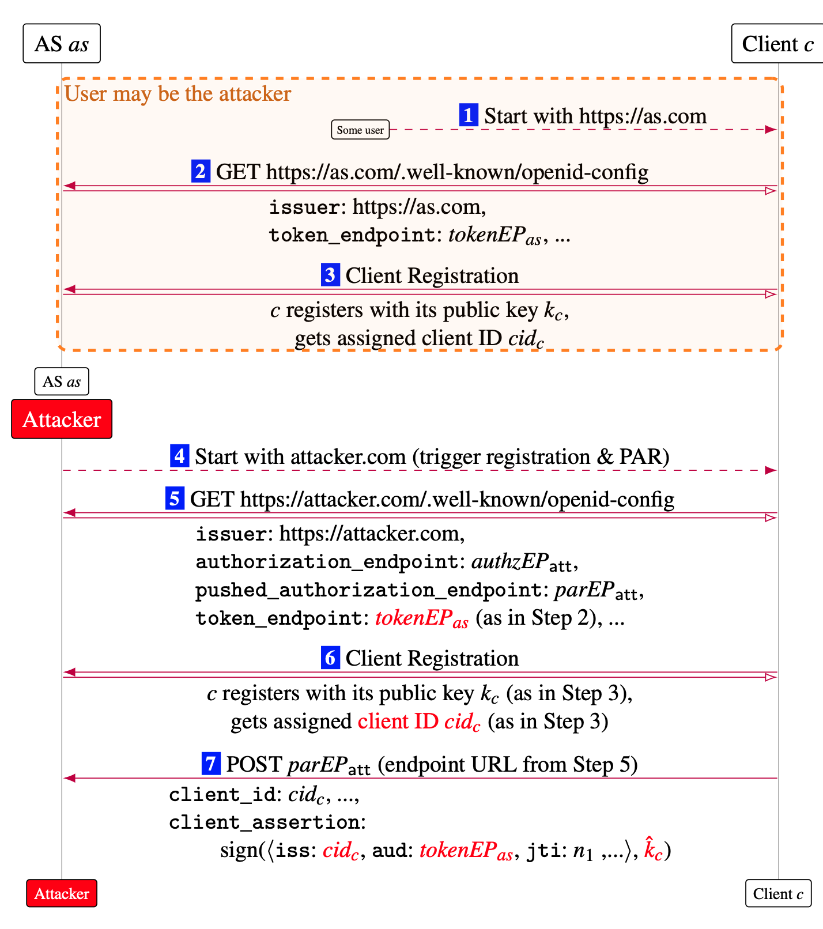
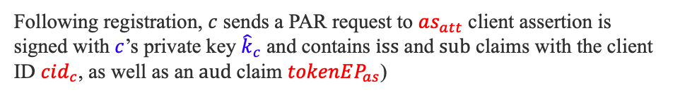
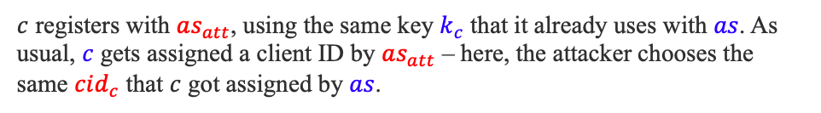
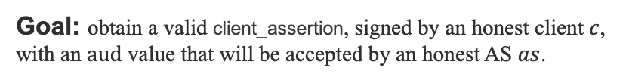

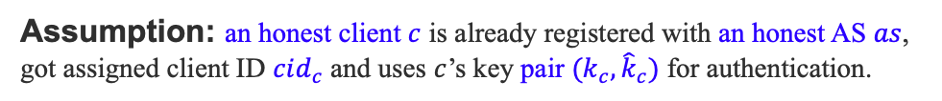
Audience Injection (first attack phase)
Goal: obtain a valid client_assertion, signed by an honest client $c$, with an $aud$ value that will be accepted by an honest AS $as$.
Assumption: an honest client $c$ is already registered with an honest AS $as$, got assigned client ID $cid_{c}$ and uses $c$’s key pair $(k_{c}, {\hat{k}}_{c})$ for authentication.
4
the attacker poses as a user of $c$ attempting to authenticate with an attacker-controlled AS $as_{att}$.
👿
user
5
Client $c$ retrieves $as_{att}$’s configuration document, which falsely lists $tokenEP_{as}$ ($c$ uses $tokenEPas$ as the token endpoint in all subsequent interactions with $as_{att}$.)
$c$ registers with $as_{att}$, using the same key $k_{c}$ that it already uses with $as$. As usual, $c$ gets assigned a client ID by $as_{att}$ – here, the attacker chooses the same $cid_{c}$ that $c$ got assigned by $as$.
6
7
Following registration, $c$ sends a PAR request to $as_{att}$ client assertion is signed with $c$’s private key ${\hat{k}}_{c}$ and contains $iss$ and $sub$ claims with the client ID $cid_{c}$, as well as an $aud$claim $tokenEP_{as}$)

Slide 6
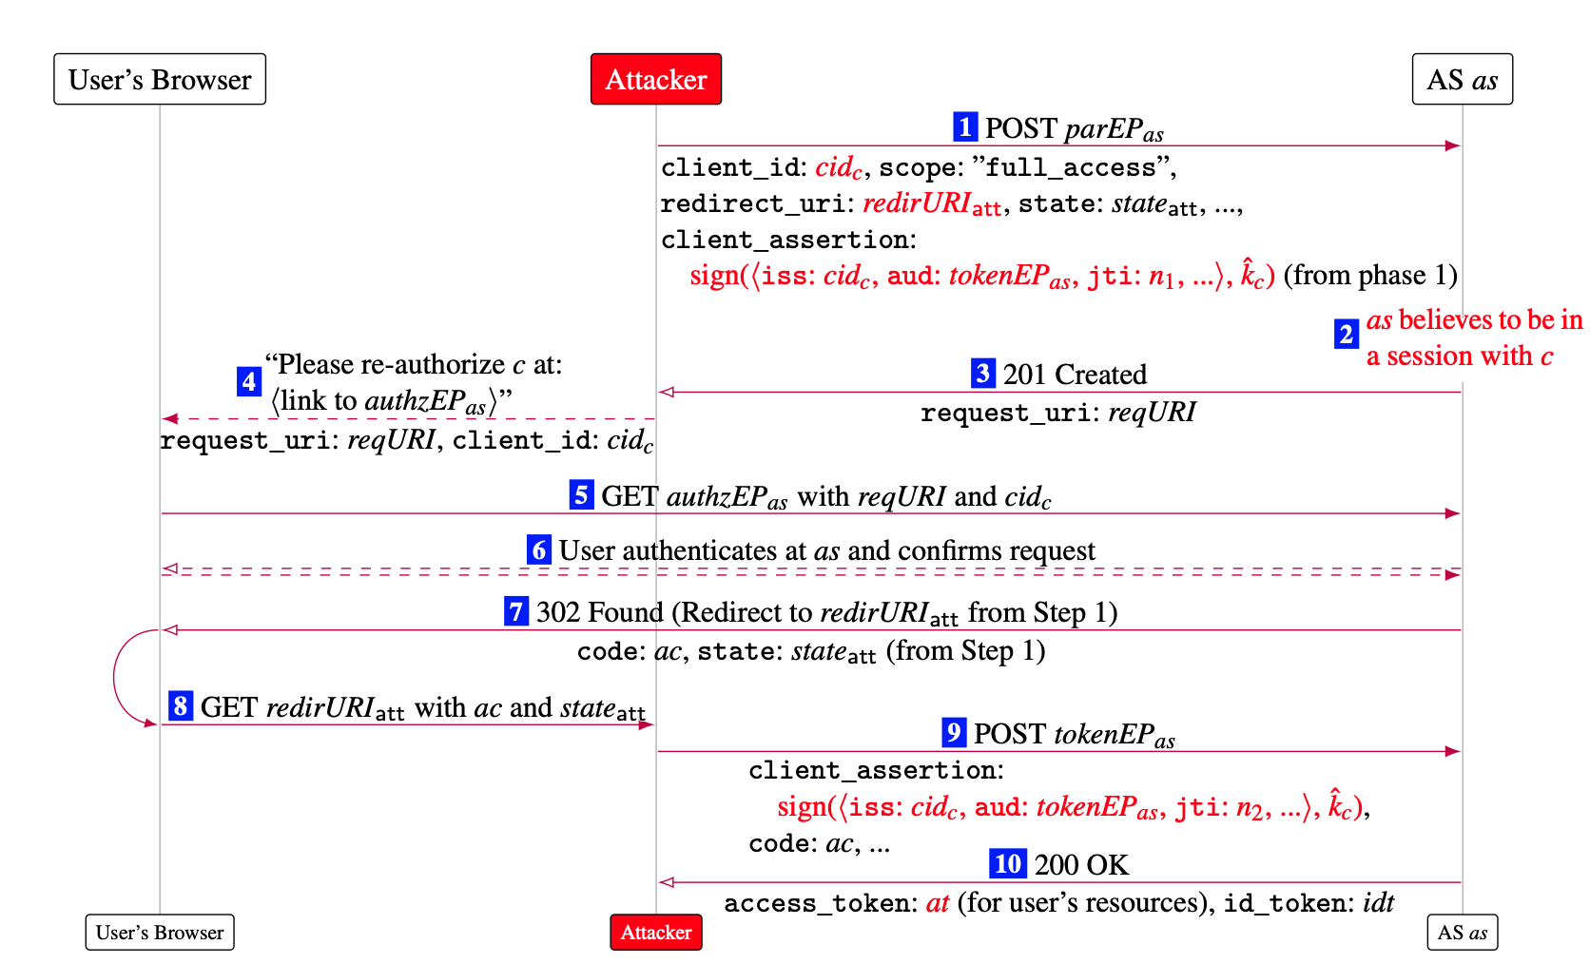
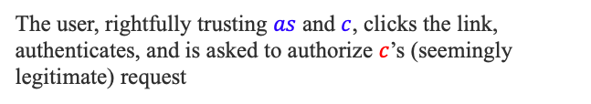
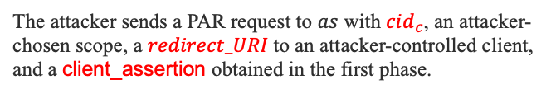

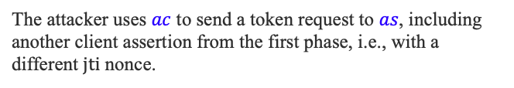
Audience Injection (second attack phase)
Client
Goal: use one or more client assertions to gain access to user’s resources or to log in to a client under an honest user’s identity
1
The attacker sends a PAR request to $as$ with $cid_{c}$, an attacker-chosen scope, a $redirect_URI$to an attacker-controlled client, and a client_assertion obtained in the first phase.
~
3
4
The attacker persuades the user to follow a link to $as$’s authorization endpoint (re-authorization)
The user, rightfully trusting $as$ and $c$, clicks the link, authenticates, and is asked to authorize $c$’s (seemingly legitimate) request
6
The attacker uses $ac$ to send a token request to $as$, including another client assertion from the first phase, i.e., with a different $jti$ nonce.
9
Result: The adversarial client $c$ impersonates an honest client $c$ to access the resources stored in $as$)

Slide 7
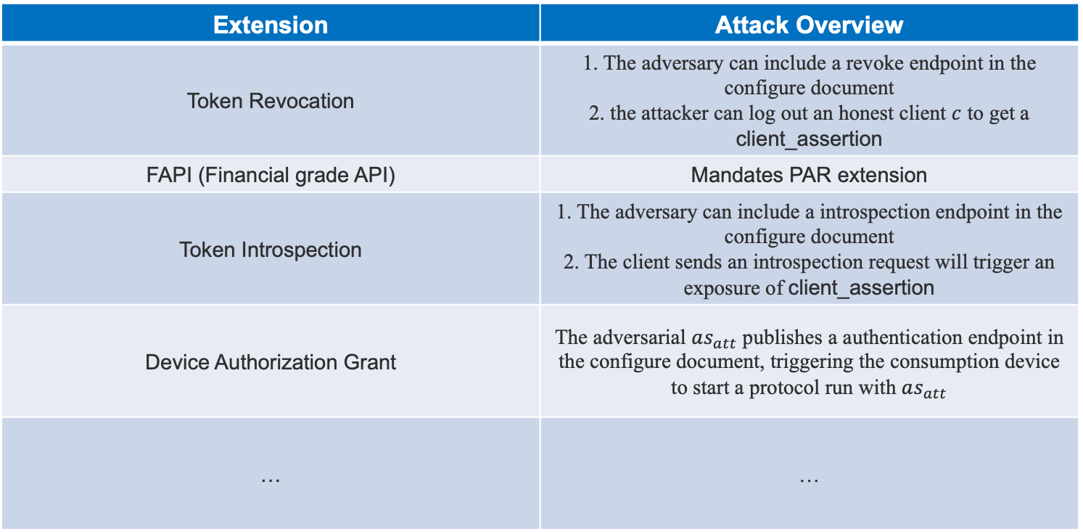
Further Audience Injection Attack Instances
Further Instances of the First Attack Phase (without Pushed Authorization Request)
Extension | Attack Overview
Token Revocation | 1. The adversary can include a revoke endpoint in the configure document 2. the attacker can log out an honest client $c$ to get a client_assertion
FAPI (Financial grade API) | Mandates PAR extension
Token Introspection | 1. The adversary can include a introspection endpoint in the configure document 2. The client sends an introspection request will trigger an exposure of client_assertion
Device Authorization Grant | The adversarial $as_{att}$ publishes a authentication endpoint in the configure document, triggering the consumption device to start a protocol run with $as_{att}$
… | …

Slide 8
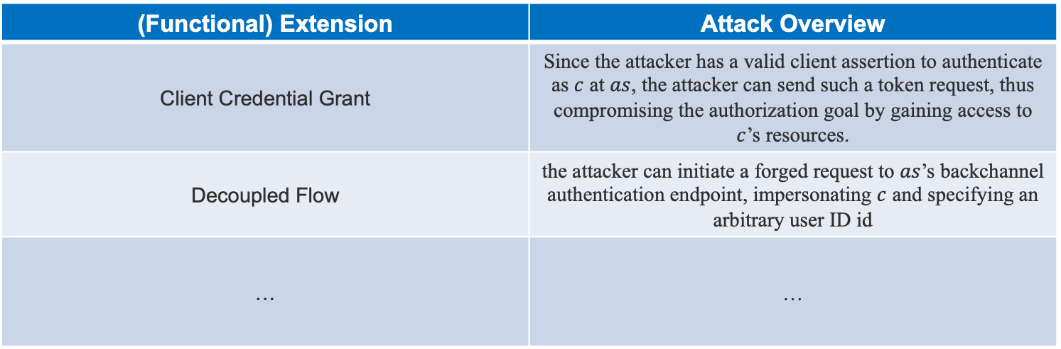
Further Audience Injection Attack Instances
Further Instances of the Second Attack Phase (with an signed client_assertion from the honest)
(Functional) Extension | Attack Overview
Client Credential Grant | Since the attacker has a valid client assertion to authenticate as $c$ at $as$, the attacker can send such a token request, thus compromising the authorization goal by gaining access to $c$’s resources.
Decoupled Flow | the attacker can initiate a forged request to $as$’s backchannel authentication endpoint, impersonating $c$ and specifying an arbitrary user ID id
… | …

Slide 9
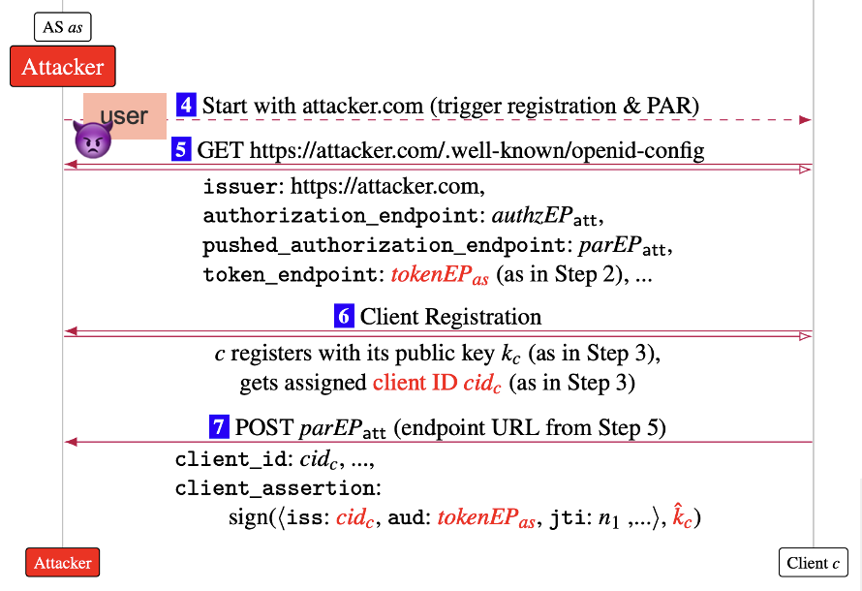
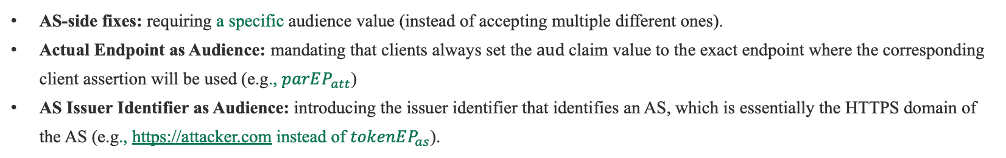
Fixes
First Phase: the ability of an attacker to trick an honest client into sending a client assertion with an attacker-chosen aud claim value A to an attacker-controlled endpoint B.
AS-side fixes: requiring a specific audience value (instead of accepting multiple different ones).
Actual Endpoint as Audience: mandating that clients always set the $aud$claim value to the exact endpoint where the corresponding client assertion will be used (e.g., $parEP_{att}$)
AS Issuer Identifier as Audience: introducing the issuer identifier that identifies an AS, which is essentially the HTTPS domain of the AS (e.g., https://attacker.com instead of $tokenEP_{as}$).
1
2
3
1
2
3

